Slide 1
PROJECT TITLE : A smart AI based solution for traffic management on routes with heavy traffic from different directions, with real-time monitoring and adaptation of traffic light timings along with parking slots detection
PIP104 University Project-II
Viva Voice
Batch Number:CSE-87
Roll Number | Student Name
20211CSE0573 | Sannidhi N C
20211CSE0557 | Deepthi A
20211CSE0544 | M Naveen Reddy
20211CSE0549 | Korapathi Keerthan Reddy
Under the Supervision of,
Dr. Jayanthi Kamalasekaran
Associate Professor
School of Computer Science & Engineering
Presidency University

Slide 2
Introduction
Abstract:
Project enhances traffic management using real-time predictions with machine learning algorithms and techniques.
Admin module manages parking slots, views booking requests, and approves or declines user bookings.
User module allows registration, login, parking slot viewing, and easy booking of available slots.
Provides traffic forecasts, parking slot predictions, and live updates including emergency and normal traffic flow.
Utilizes image-based detection and real-time data to monitor and predict traffic conditions accurately.
Aims to reduce traffic congestion and improve urban mobility through intelligent transportation systems.

Slide 3
Literature Review
S. No. | Author(s) | Year | Title | Outcome
1 | Lv, Y., Duan, Y., Kang, W., Li, Z., & Wang, F.-Y. | 2015 | Traffic Flow Prediction With Big Data: A Deep Learning Approach | Used stacked autoencoders to improve real-time traffic forecasting accuracy using big data.
2 | Ma, X., Tao, Z., Wang, Y., Yu, H., & Wang, Y. | 2015 | Long Short-Term Memory Neural Network for Traffic Speed Prediction Using Remote Microwave Sensor Data | Applied LSTM networks for accurate short-term traffic speed prediction using sensor data.
3 | Zhang, J., Zheng, Y., & Qi, D. | 2017 | Deep Spatio-Temporal Residual Networks for Citywide Crowd Flows Prediction | Introduced deep residual networks to predict citywide traffic flows, capturing spatiotemporal dependencies.
4 | Yuan, Y., Zhou, S., & Yang, T. | 2016 | Parking Slot Detection Based on Deep Learning | Proposed CNN-based model for real-time parking slot detection with enhanced accuracy.
5 | Bui, M., Pham, H., & Nguyen, T. | 2019 | Real-Time Traffic Prediction Using Support Vector Machines | Demonstrated the effectiveness of SVM in predicting real-time traffic patterns from historical data.

Slide 4
Research Gaps
Static Management: Lacks real-time updates, resulting in inefficient allocation of parking slots and resources.
No Predictive Capability: Unable to anticipate traffic congestion or vehicle volumes, leading to delays and poor planning.
Limited Emergency Response: Insufficient handling of emergencies such as ambulance clearance or rapid vehicle rerouting.
Higher Congestion Levels: Prolonged traffic jams due to outdated infrastructure and no integration with live data.
Increased Driver Frustration: Longer wait times and unreliable information cause inconvenience for users.

Slide 5
Proposed Methodology
Real-Time Insights: Provides live traffic updates and parking slot predictions for more informed decision-making.
Improved Efficiency: Reduces congestion and wait times by dynamically adjusting to current traffic conditions.
Enhanced Emergency Handling: Prioritizes emergency vehicles, ensuring faster response times and improved road safety.
User-Friendly Experience: Simplifies parking slot bookings and traffic navigation through a streamlined, accessible interface.
Data-Driven Approach: Leverages machine learning to continuously refine predictions and adapt to evolving traffic patterns.

Slide 6
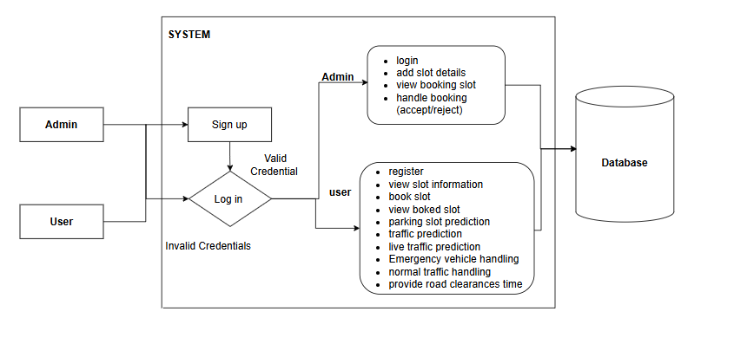
Methodology

Slide 7
Objectives
Develop a predictive model for traffic and parking slot availability.
Enhance decision-making during emergencies.
Improve urban mobility by reducing congestion.
Ensure real-time updates for parking and traffic conditions.

Slide 8
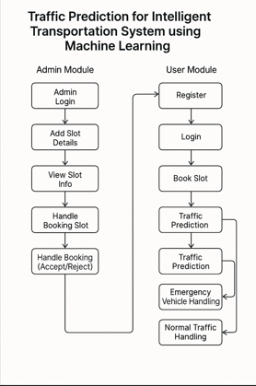
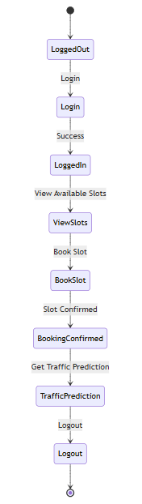
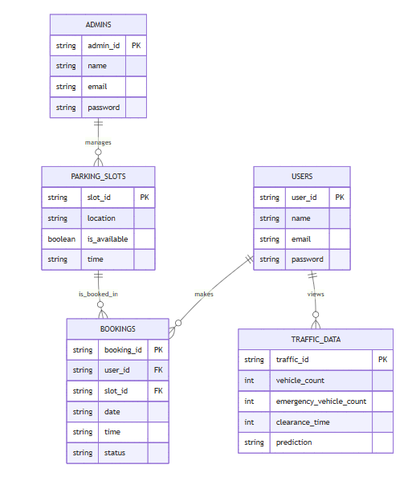
System Design and Implementation
Project Flow UML Diagram ER Diagram

Slide 9
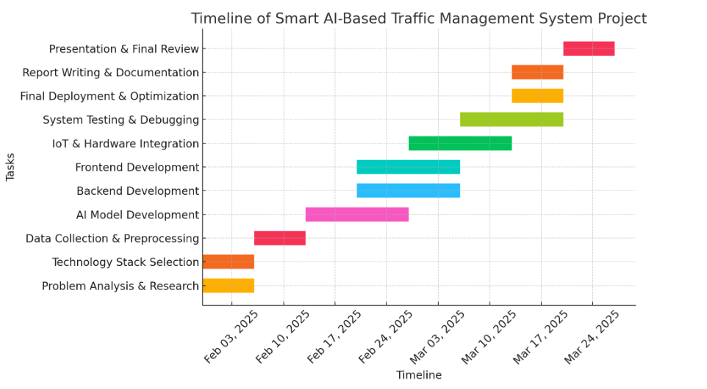
Timeline of Project

Slide 10
Outcomes
1. Admin Module :
Admin Login:
The system shall allow the admin to log in using valid credentials.
Add Slot Details:
The admin shall be able to add new parking slot information including location, slot ID, and availability status.
View Booking Slots:
The system shall enable the admin to view all the booking requests made by users.
Handle Booking Requests (Accept/Reject):
The system shall allow the admin to approve or reject booking requests based on availability.
2. User Module :
User Registration and Login:
The system shall allow new users to register and existing users to log in securely.
View Slot Information:
Users shall be able to browse available parking slots, including location and availability.
Book Parking Slot:
Users shall be able to book an available parking slot by specifying the required time and location.

Slide 11
Outcomes
View Booked Slots:
Users shall be able to view the details of their current and past slot bookings.
Parking Slot Prediction (via API Image):
The system shall use image-based data to predict the availability of parking slots in real time.
Traffic Forecasting:
The system shall provide users with future traffic trends using machine learning models.
Live Traffic Prediction:
Users shall be provided with live traffic updates based on vehicle count, emergency vehicle movement, and road clearance status.
Emergency Vehicle & Clearance Handling:
The system shall prioritize traffic prediction for emergency scenarios and calculate road clearance time to assist with rerouting

Slide 12
References
Lv, Y., Duan, Y., Kang, W., Li, Z., & Wang, F.-Y., "Traffic Flow Prediction With Big Data: A Deep Learning Approach," IEEE Transactions on Intelligent Transportation Systems, 2015.
Available at: https://ieeexplore.ieee.org/document/7111151
Ma, X., Tao, Z., Wang, Y., Yu, H., & Wang, Y., "Long Short-Term Memory Neural Network for Traffic Speed Prediction Using Remote Microwave Sensor Data," Transportation Research Part C, 2015.
Available at: https://www.sciencedirect.com/science/article/pii/S0968090X15000391
Zhang, J., Zheng, Y., & Qi, D., "Deep Spatio-Temporal Residual Networks for Citywide Crowd Flows Prediction," AAAI Conference on Artificial Intelligence, 2017.
Available at: https://aaai.org/ocs/index.php/AAAI/AAAI17/paper/view/14617
Yuan, Y., Zhou, S., & Yang, T., "Parking Slot Detection Based on Deep Learning," IEEE International Conference on Image Processing (ICIP), 2016.
Available at: https://ieeexplore.ieee.org/document/7782885

Slide 13
References
Bui, M., Pham, H., & Nguyen, T., "Real-Time Traffic Prediction Using Support Vector Machines," International Journal of Computer Applications, 2019.
Available at: https://www.ijcaonline.org/volume19/number2/pxc3872351
Zheng, Y., Liu, F., & Zhang, L., "Urban Computing with Spatiotemporal Intensity Maps: A Survey," IEEE Transactions on Knowledge and Data Engineering, 2017.
Available at: https://ieeexplore.ieee.org/document/7552627
He, H., & Wu, J., "Real-Time Parking Availability Prediction with Data Mining: A Case Study," International Journal of Intelligent Systems, 2018.
Available at: https://onlinelibrary.wiley.com/doi/abs/10.1002/int.21969

Slide 14
Publication Details
Published Website:International Journal of Innovative Research in Computer and Communication Engineering
https://ijircce.com/admin/main/storage/app/pdf/KncZkUlfJpZ8Gc3V0WFro1cV0BXVKVgKjYwuJHZh.pdf
or
https://ijircce.com/get-current-issue.php?key=MTY4

Slide 15
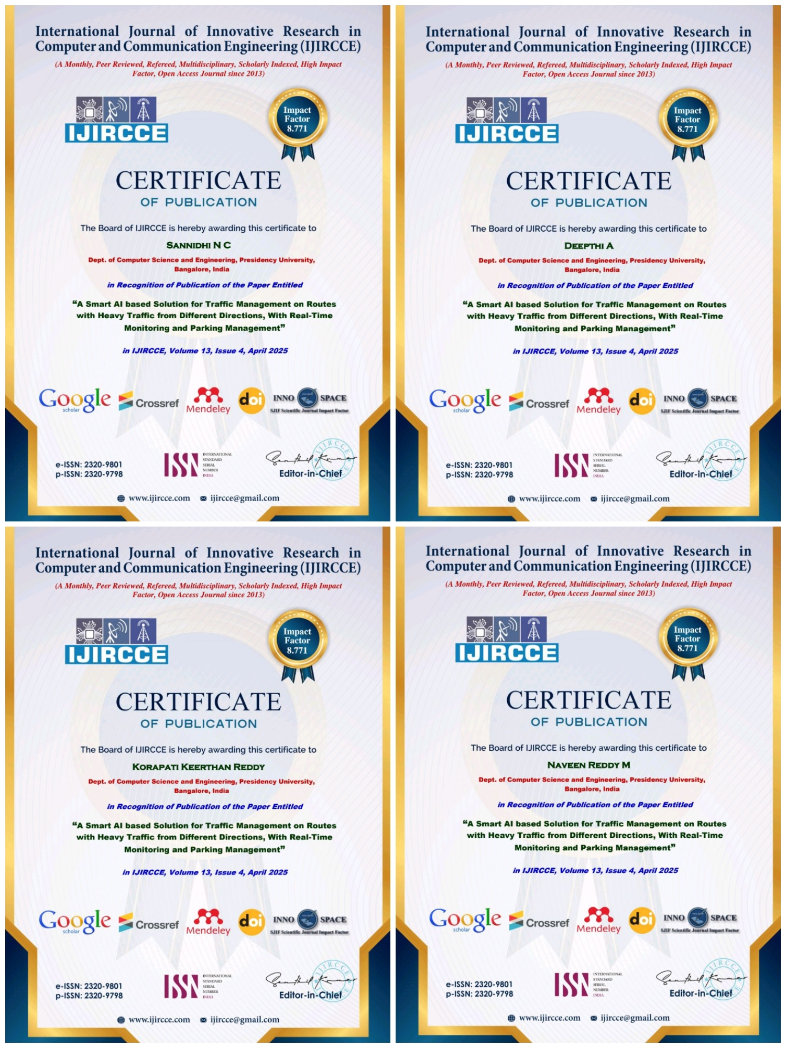
Achievements
Published Website:International Journal of Innovative Research in Computer and Communication Engineering

Slide 16
Thank You

